Slide 1
Industrial revolution:
By: Chandler Moya

Slide 2
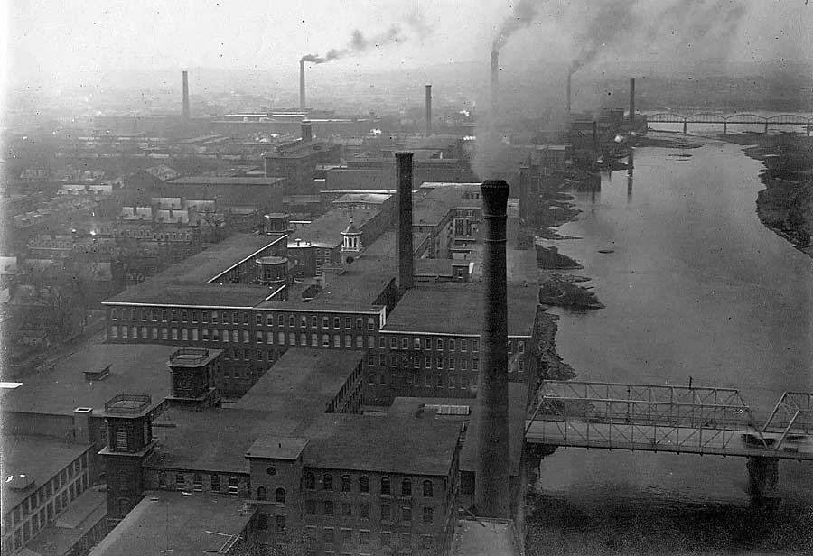
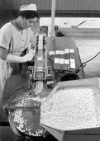
Technological developments
Chemicals: The large scale production of chemicals was an important development during the Industrial Revolution. The first production of chemicals was Sulphuric acid. Production of Alkali on a large scale became an important goal as well, and was succeeded in 1791 by Nicolas Leblanc.

Slide 3
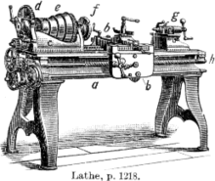
Technological developments
Machine tools: The Industrial Revolutions could not have developed without Machine tools, they enabled manufacturing machines to be made.

Slide 4
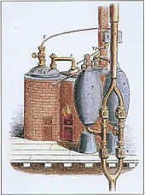
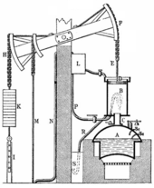
Technological developments
Steam power: The development of the Stationary Steam Engine was an essential early element of the Industrial Revolution. However during most of the period of the Revolution, the majority of industries still relied on wind, water power, animals and man power to drive the machines.

Slide 5
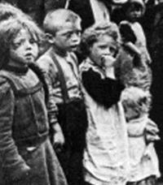
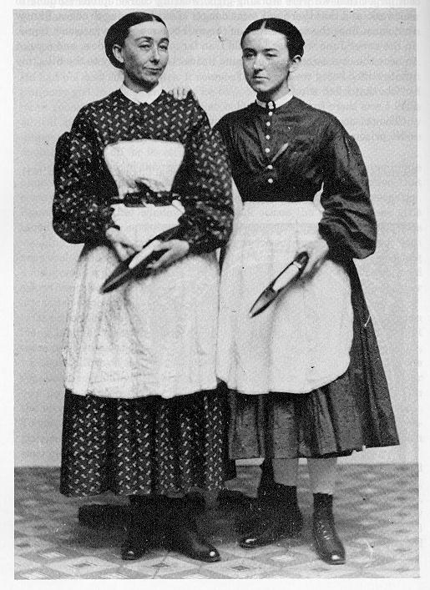
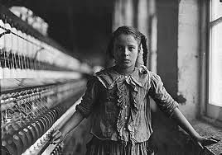
The opportunity
The Industrial revolution gave mothers, children and men the ability to have their own money and to work out side the house.

Slide 6
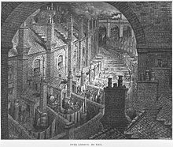
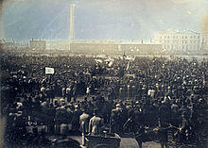
Living conditions
Do to high populations, it was common to have chronic hunger and malnutrition. In 1750 life expectancies in France was about 35 years, and only slightly higher in England.

Slide 7
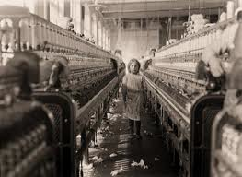
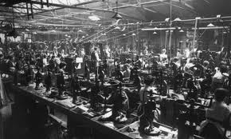
Working conditions
During the time of the Industrial Revolution there was no such thing as a safe working place. Working in places such as the cotton trade demanded long work hours(10+) and the age of most workers were 8 and 12. Because the children were so small they were able to fit in between tightly packed machinery which was vary dangerous and sometimes lead to death.

Slide 8
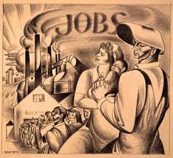
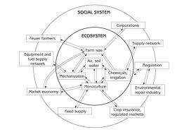
Social Effects
In term of social structure, the industrial Revolution witnessed the triumph of the middle class of industrialists and businessmen over a landed class of nobility and gentry.
Ordinary people were able to find employment in places like mill and factories.

Slide 9
Women
Most women found jobs in domestic service, textile factories and piece work shops. Some even worked in coal mines. This allowed women to gain independent wages.

Slide 10
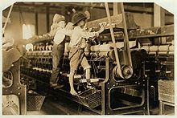
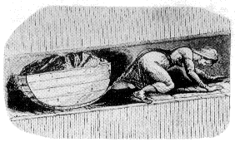
Children
Children as young as 6 worked hard hours for little or no pay. Some worked up to 19 hours a day, with a one hour brake total. If the hours weren’t bad enough already, they had to work near big large, heavy and dangerous equipment. Many accidents happened, resulting in injures or death.

