Slide 1
Studio tours
By: Cici Moya

Slide 2
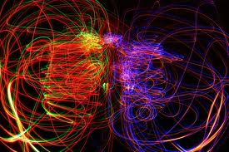
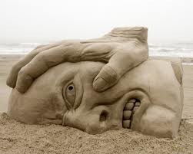
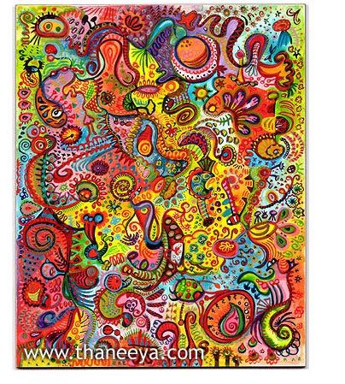
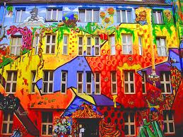
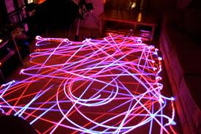
What is art??
Work produced by such skill and imagination.
Light art<3
Sand art(:
Colorful art

Slide 3
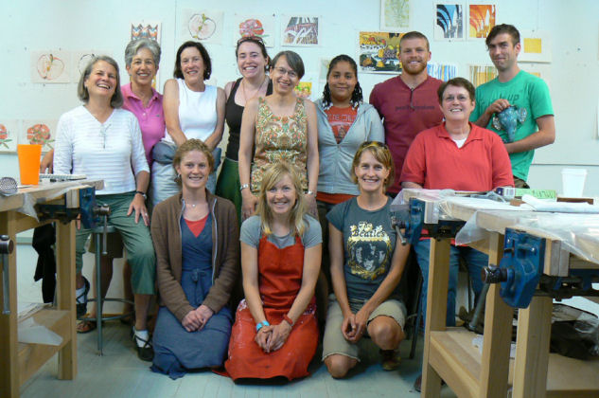
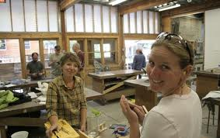
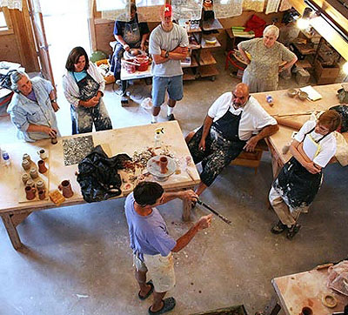
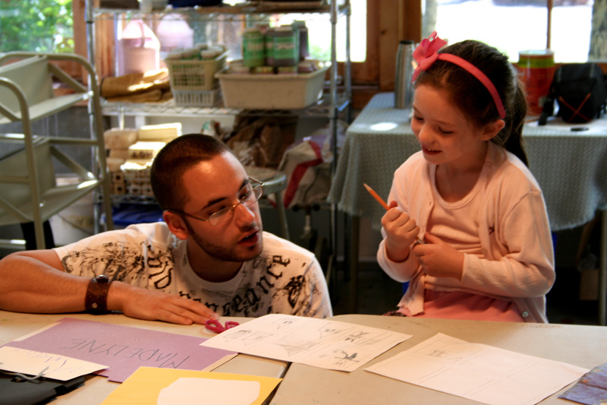
Anderson ranch(:
Once in a life time:)
Unique<3
Amazing!

Slide 4
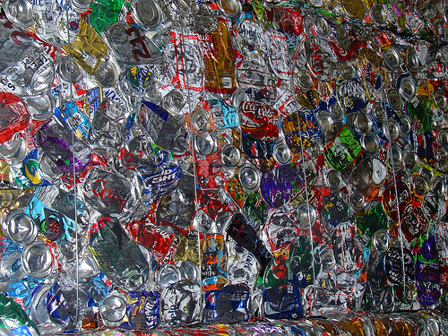
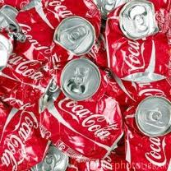
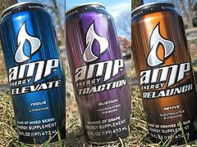
Wyly community art center
Nicole

Slide 5
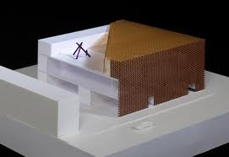
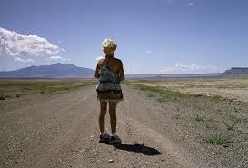
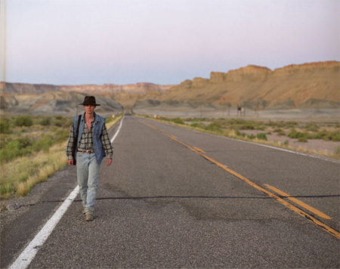
Aspen art museum
New art museum:)
Slater Bradley!
Huma Bhabha*

Slide 6
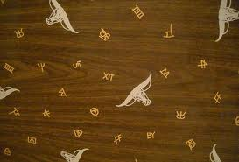
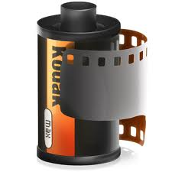
Kathy Honey

Slide 7
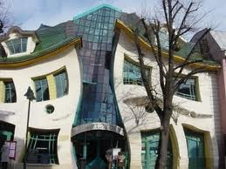
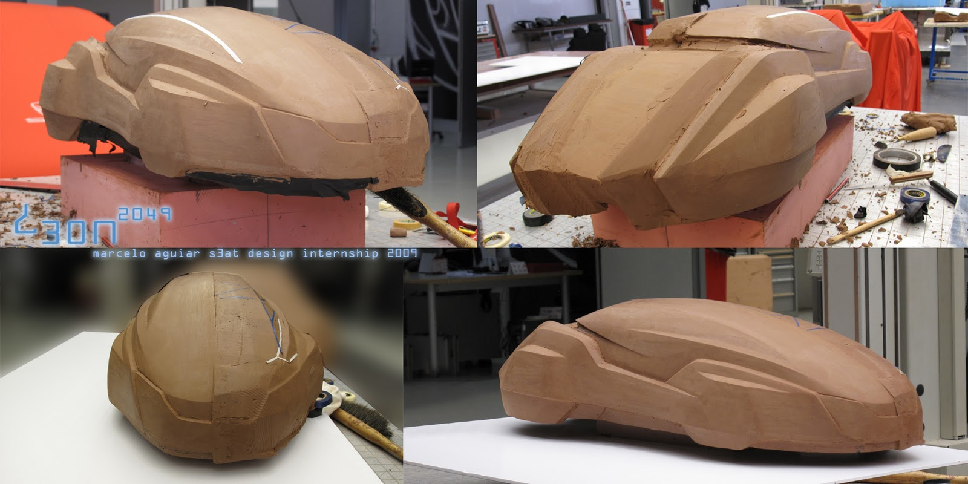
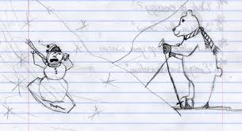
What makes a artist
What makes artist? I believe everyone is a artist. Having a passion about something makes it art. Some forms of artwork would be cooking, building houses, making cars and when it comes to Yampah students a lot of our worksheets see a little artwork.

Slide 8
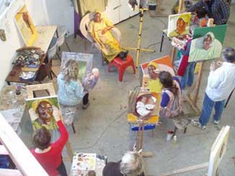
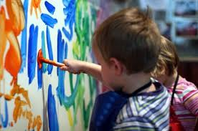
Education requirements
A must needed requirement to become a artist is to have passion! Some people stumble on the gift of creativity but some others learn.

Slide 9
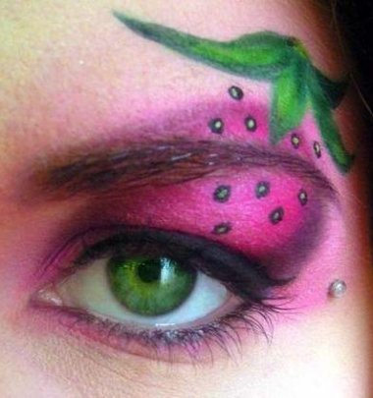
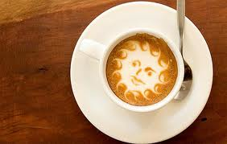
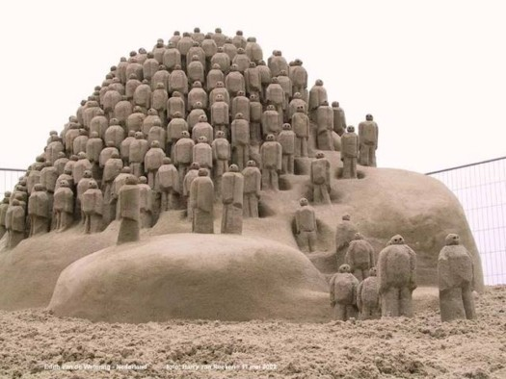
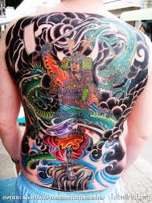
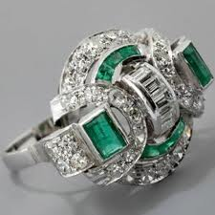
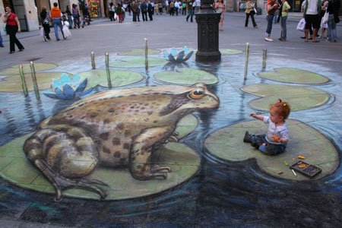
What I see as art (:

Slide 10
My reflection <3
This last week I went to a few places I have never been. I learned you don’t have to be a paid artist I do something you love doing. I think my favorite place we visited was the glass lady’s house. All the work she has done is beautiful!! I believe if I was to become a artist I would want to get in to glass art. The lady seemed to love what she did and her attitude was inspiring.

