Slide 1
Arcadia
By: Chandler Moya

Slide 2
The Royal family
Previous King and Queen
Philip 1and Bellona
Children
First born: Cynane
Second born: Jerome
After Jerome’s death his sister Cynane became queen of Amida.

Slide 3
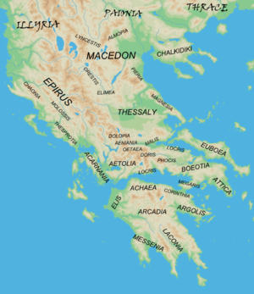
Time and place
The year is 650bc and the
land has been at war for many
years. A fight to rule all of
Greece. The only safe haven is
Arcadia.

Slide 4
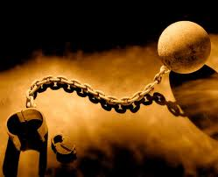
Law of the land
Law one: Those who commit an act of violence toward another, and found guilty is exiled.
Law Two: If accused of a crime you have a right to a trial
Law Three: Only citizens of Arcadia can be apart of the Government.
Law four: Murder is punishable by death.

Slide 5
Government
Arcadias government is run by the Queen and Aradian citizen’s. Women who have potential have the ability to be apart of the government. All citizens are equal in the eyes of the law. Their main priority is the safety and well-far of the people.

Slide 6
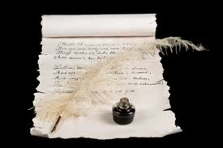
Education
All children, both boys and girls are to have a decent education. Music, reading, writing and math are among the many thing that are needed to learned to become a effective citizen. Boys and young men are to learn athletics for military service. However if a young girls shows potential, they will join the boys in the arts of war.

Slide 7
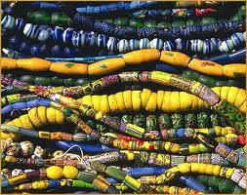
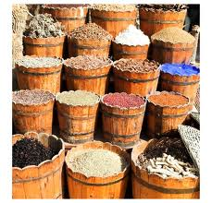
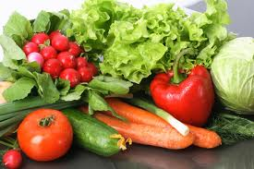
Barter system
Living in a land of rich soil, the people would trade their goods or their services for other peoples good’s and services.

Slide 8
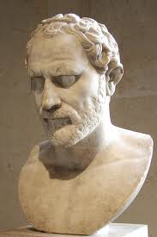
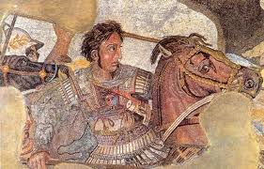
Foreign policy
All Foreigner’s are treated as a threat until they prove they have good intentions. During a time of war we have to protect our own and in doing so, we have to keep all threats out and that includes other governments.

Slide 9
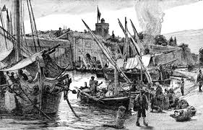
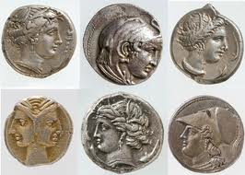
Isolationism
To keep apart of other affairs, we trade with other cities. Only trusted Kings and Queens may enter Arcadia. The Queen would travel with a small army, for her protection, to other cities.

Slide 10
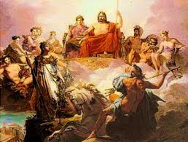
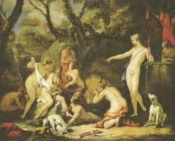
Religion
In arcadia we worship many different gods, but if you are a new to Arcadia you may worship who ever you want. In Arcadia we pride ourselves in religious tolerance.

